Slide 1
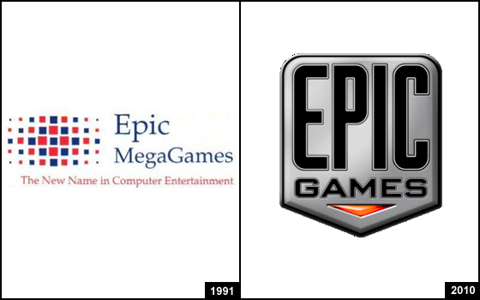
REVOLUTION IN THE TECH INDUSTRY

Slide 2

REGINA HONU
Is a Ghanaian Social Entrepreneur, software developer and founder of Soronko solutions, a software development company in Ghana.
She also opened Soronko Academy, the first coding and Human-centered design school for children and young adults in West Africa.

Slide 3
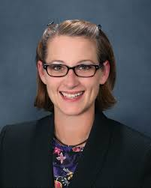
DOROTHY K. GORDON
Is a Ghanaian technology activist and development specialist.
Was the founding director general of the Ghana-INDIA Kofi Annan Centre of Excellence in ICT.

Slide 4

SANDRA ABROKWA OWUSU-KYEREMATEN
She is a Ghanaian pioneer of Saltside Technologies Tonaton delivery service.
Is a country Director of Ghana Online Media who soothe fears of skeptical online users.
Her unique ability is to fuse technology, marketing and commercial industry together.

Slide 5
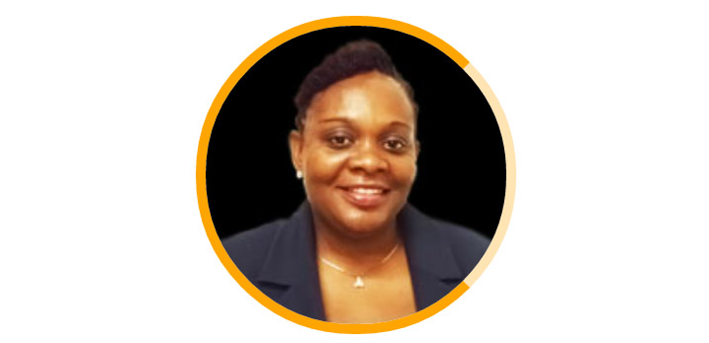
HARRIET YARTEY
Is a Ghanaian Managing Director of Computer Warehouse Group.
It’s a full service IT company providing products and services that cut across the ICT value chain of hardware, software and communications in Africa.

Slide 6

ESTELLE AKOFIO SOWAR
Is a Ghanaian businesswoman and the current Csquared Ghana Country Manager and former Google Ghana country manager.
Was once the managing director of Busy Internet in Ghana.

Slide 7

ANGELA KYEREMATEN-JIMOH
Is a Ghanaian business leader.
Currently the Country General Manager of IBM Ghana.
Is the first women to become country director of IBM in Africa.
IBM is an American multinational technology company started in 1911 as the Computing –Tabulating-Recording Company(CTR).
Was later named as International Business Machines (IBM) in 1924.
It supports Ghana with modern technology for efficient service delivery.

Slide 8

JOSEPH SIAW AGYEPONY
Is the serial entrepreneur and founder of the Jospong Group of Companies.
He is also the CEO of Zoomlion.
Jospong Group is one of the most diversified holdings companies in Ghana with operations in other African countries and Asia.
Their core is to identify gaps, churn out innovative businesses and build capacities to provide value and nurture them to become market leaders.

Slide 9
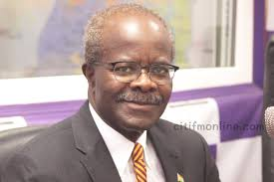
DR PAA KWESI NDUOM
He is a Ghanaian business consultant and politician.
He has created 65 businesses around the world , with the bulk of it operating in Ghana.
His businesses mostly fall in banking/finance, hospitality and media categories e.g. GN bank and GN quarry.

Slide 10
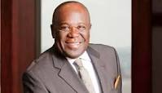
DR. SAMUEL ESSON JONAH
Is a Ghanaian businessman, the Executive Chairman of Jonah Capital, an equity fund based in Johannesburg.
Was a president of AngloGold Ashanti and shared the strategic leadership of the company with its CEO, Bobby Gogsell.
Jonah capital is a private company with a portfolio of assets primarily in the mineral resource sector in sub-Saharan Africa.

Slide 11
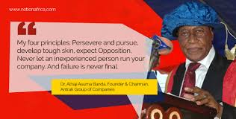
DR.ALHAJI ASOMA ABU BANDA
Is a renowned entrepreneur, business magnate and philanthropist who creates jobs to people globally through his Antrak Group of Companies.
He is the founder and chairman of Antrak Group of Companies.
He established the first Ghanaian owned Airline Company.

Slide 12
CONCLUSION
The communication and information technologies are the technical keys to improving the readiness of reserve components to serve alongside active components.

